Slide 1
IN ALL PLACES

Slide 2
CALL TO WORSHIP
“I looked, and there before me was a great multitude that no one could count, from every nation, tribe, people and language, standing before the throne and before the Lamb. They were wearing white robes and were holding palm branches in their hands. And they cried out in a loud voice:
“Salvation belongs to our God, who sits on the throne, and to the Lamb.”
Revelation 7: 9-10

Slide 3
JOHN 6: 25 - 35
25 When they found him on the other side of the lake, they asked him, “Rabbi, when did you get here?”
26 Jesus answered, “Very truly I tell you, you are looking for me, not because you saw the signs I performed but because you ate the loaves and had your fill.
27 Do not work for food that spoils, but for food that endures to eternal life, which the Son of Man will give you. For on him God the Father has placed his seal of approval.”
28 Then they asked him, “What must we do to do the works God requires?”
29 Jesus answered, “The work of God is this: to believe in the one he has sent.”

Slide 4
JOHN 6: 25 - 35
30 So they asked him, “What sign then will you give that we may see it and believe you? What will you do?
31 Our ancestors ate the manna in the wilderness; as it is written: ‘He gave them bread from heaven to eat.’”
32 Jesus said to them, “Very truly I tell you, it is not Moses who has given you the bread from heaven, but it is my Father who gives you the true bread from heaven.
33 For the bread of God is the bread that comes down from heaven and gives life to the world.”
34 “Sir,” they said, “always give us this bread.”
35 Then Jesus declared, “I am the bread of life. Whoever comes to me will never go hungry, and whoever believes in me will never be thirsty.

Slide 5
JAMES 2: 14 - 18
14 What good is it, my brothers and sisters, if someone claims to have faith but has no deeds? Can such faith save them?
15 Suppose a brother or a sister is without clothes and daily food.
16 If one of you says to them, “Go in peace; keep warm and well fed,” but does nothing about their physical needs, what good is it?
17 In the same way, faith by itself, if it is not accompanied by action, is dead.
18 But someone will say, “You have faith; I have deeds.”
Show me your faith without deeds, and I will show you my faith by my deeds.

Slide 6
IN ALL PLACES

Slide 7
Rev David Turtle preaches in Namibia

Slide 8
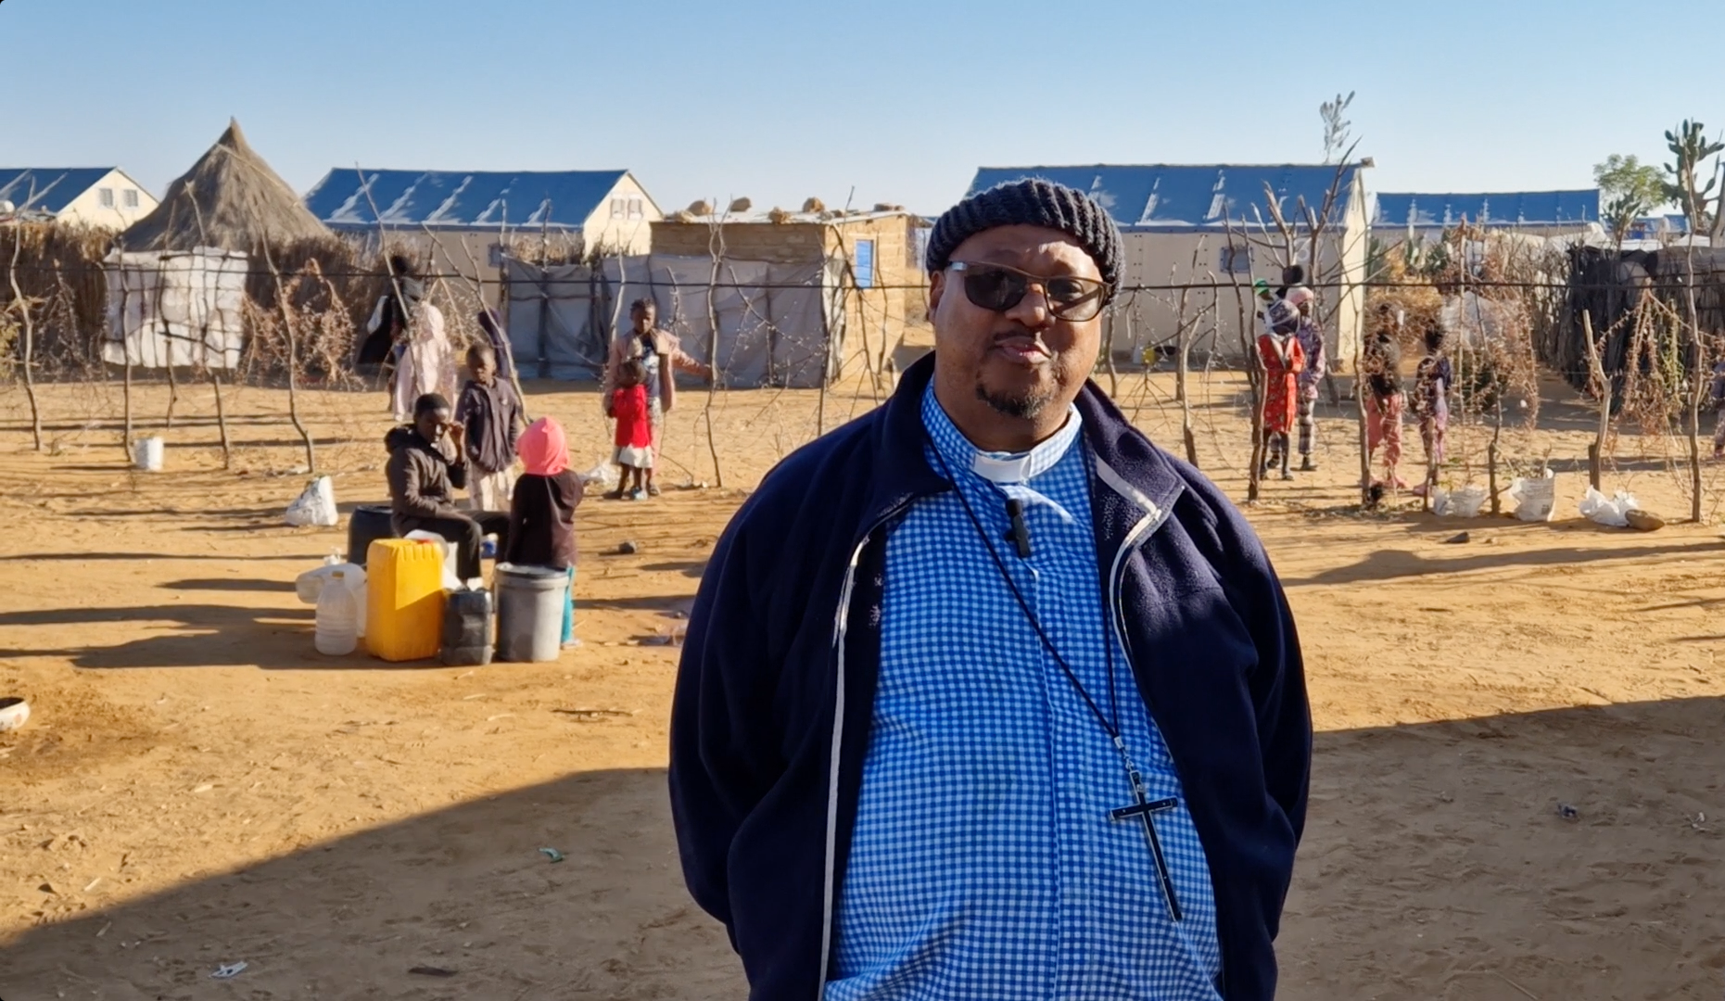
Bishop Christopher Gaya

Slide 9
Rev Everestu Kameya

Slide 10
Metzingen,
Germany

Slide 11
Pastor Bernd Schwenkschuster

Slide 12
Metzingen
Climbing Hall

Slide 13
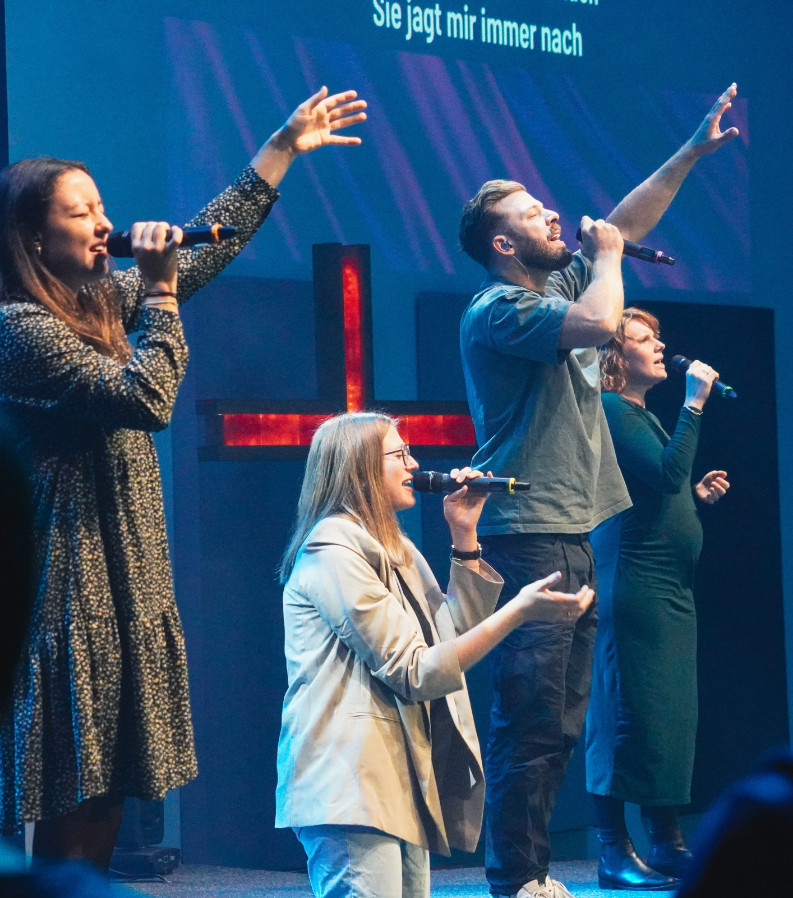
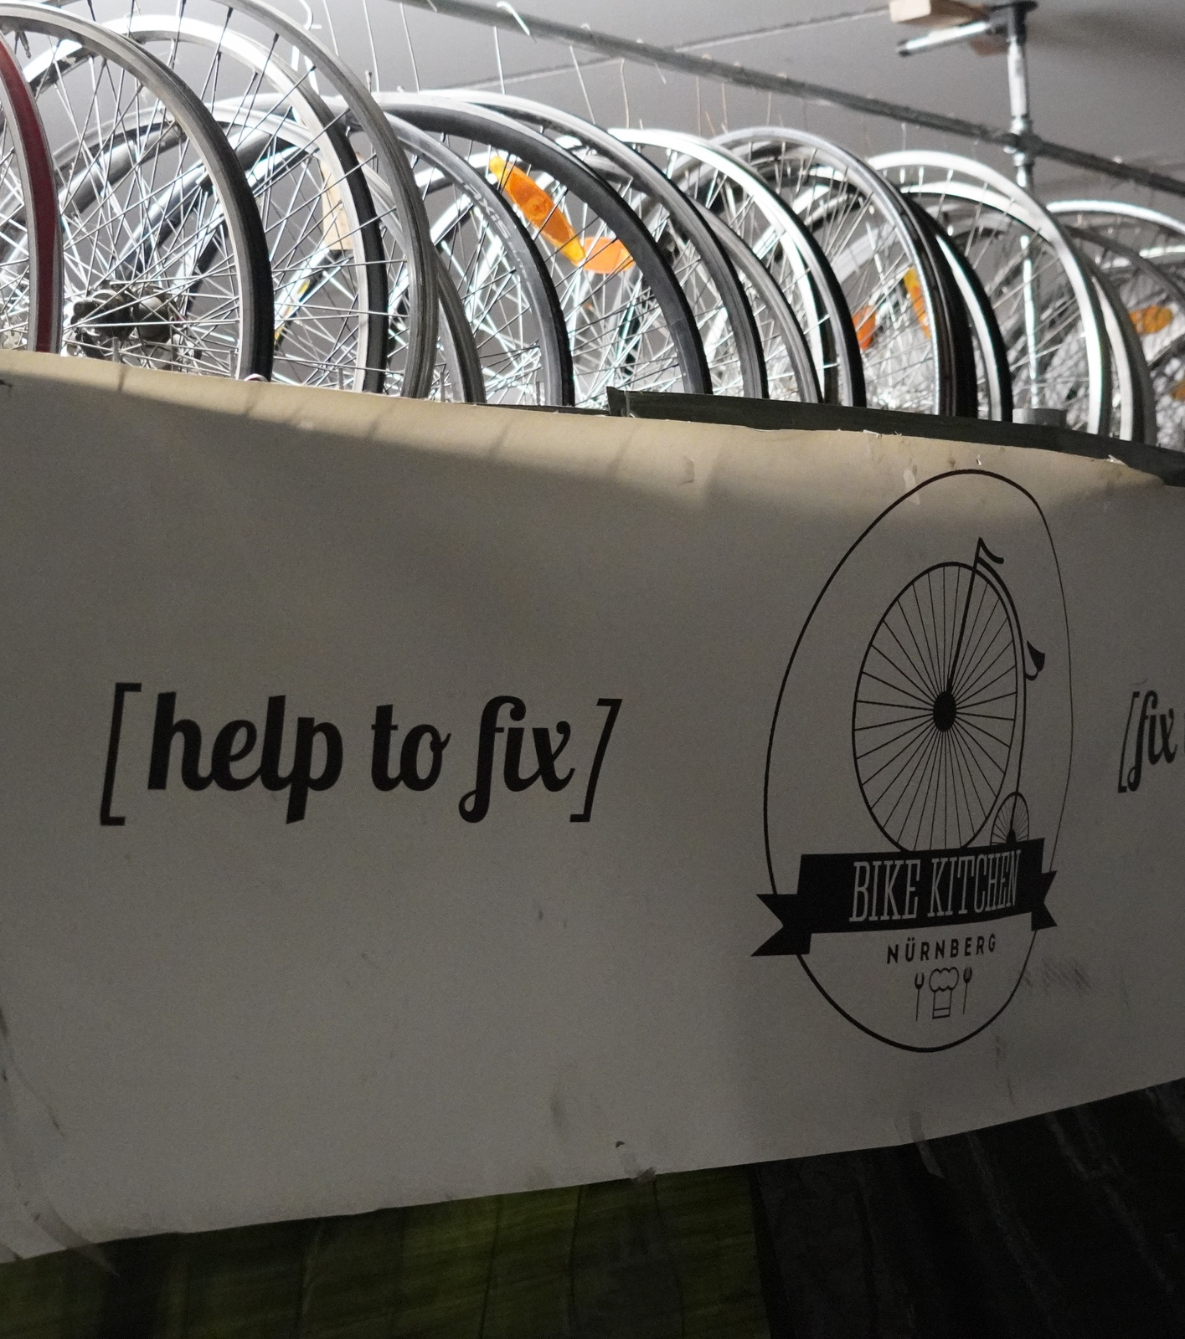
JesusCentrum

Slide 14
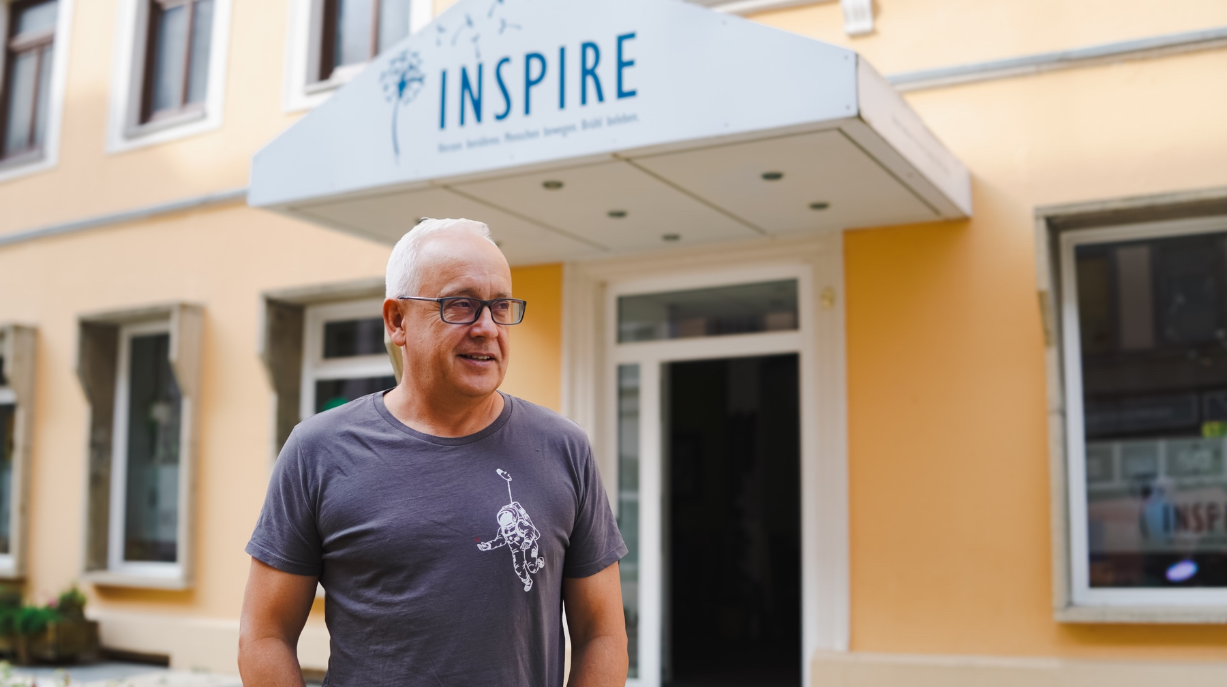
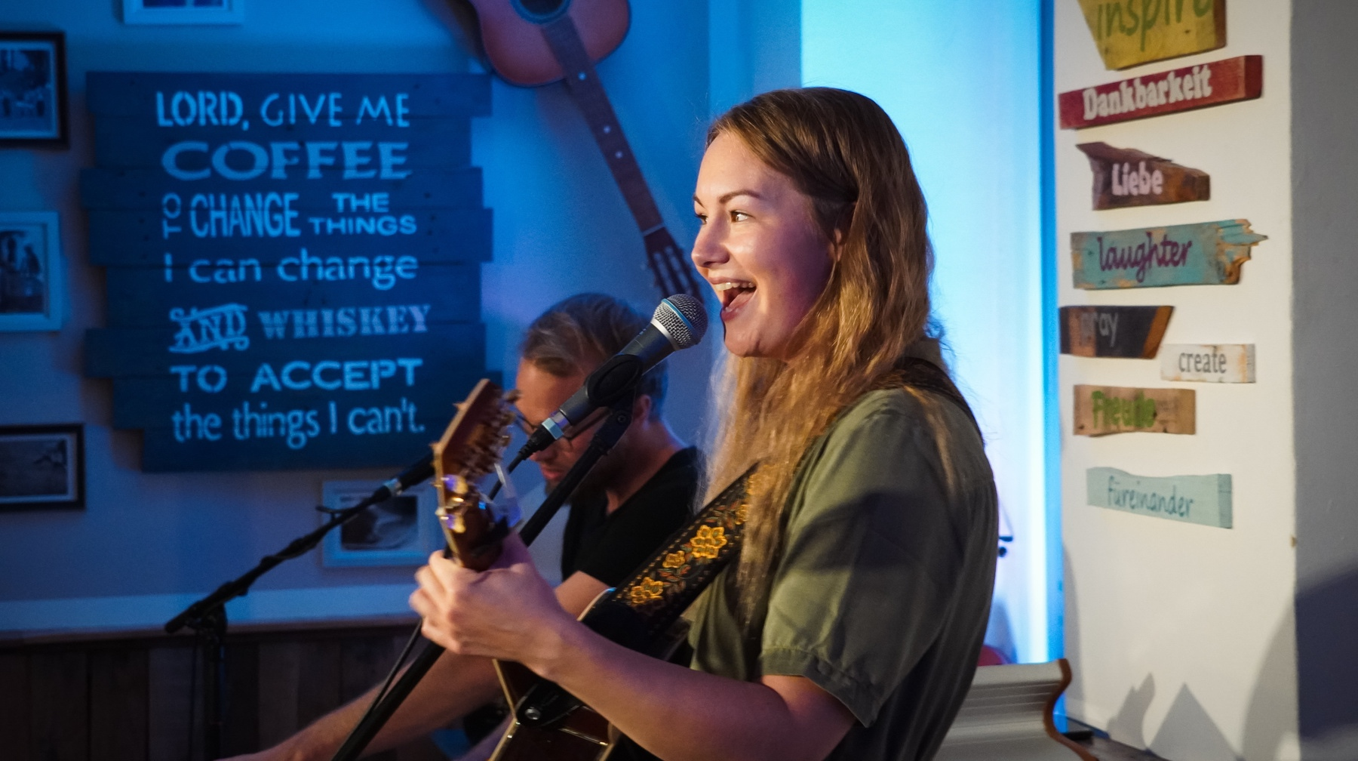
INSPIRE,
Chemnitz

Slide 18
MEET Germany

Slide 19
BLESSING
From the Methodist Church in Singapore
May God’s love strengthen you,
as together we seek to love God
by loving our neighbours.
Amen.

Slide 20
Join our WhatsApp news group
irishmethodist.org/world-mission

