Slide 1
2023/24
WHY
WORLD DEVELOPMENT
& RELIEF

Slide 2
The Lord reigns forever, and rules the nations with fairness.
The Lord is a shelter for the oppressed, a refuge in times of trouble.
Sing praises to the Lord who reigns in Jerusalem;
Tell the world about God’s unforgettable deeds.
The needy will not be ignored forever;
The hopes of the poor will not always be crushed.
Let us worship God!
WDR 2023/24

Slide 3
WHY
WORLD DEVELOPMENT
& RELIEF

Slide 4
Matthew 25: 31- 46
31 “When the Son of Man comes in his glory, and all the angels with him, he will sit on his glorious throne. 32 All the nations will be gathered before him, and he will separate the people one from another as a shepherd separates the sheep from the goats. 33 He will put the sheep on his right and the goats on his left.
34 “Then the King will say to those on his right, ‘Come, you who are blessed by my Father; take your inheritance, the kingdom prepared for you since the creation of the world. 35 For I was hungry and you gave me something to eat, I was thirsty and you gave me something to drink, I was a stranger and you invited me in, 36 I needed clothes and you clothed me, I was sick and you looked after me, I was in prison and you came to visit me.’

Slide 5
37 “Then the righteous will answer him, ‘Lord, when did we see you hungry and feed you, or thirsty and give you something to drink? 38 When did we see you a stranger and invite you in, or needing clothes and clothe you? 39 When did we see you sick or in prison and go to visit you?’
40 “The King will reply, ‘Truly I tell you, whatever you did for one of the least of these brothers and sisters of mine, you did for me.’
41 “Then he will say to those on his left, ‘Depart from me, you who are cursed, into the eternal fireprepared for the devil and his angels.
42 For I was hungry and you gave me nothing to eat, I was thirsty and you gave me nothing to drink, 43 I was a stranger and you did not invite me in, I needed clothes and you did not clothe me, I was sick and in prison and you did not look after me.’

Slide 6
44 “They also will answer, ‘Lord, when did we see you hungry or thirsty or a stranger or needing clothes or sick or in prison, and did not help you?’
45 “He will reply, ‘Truly I tell you, whatever you did not do for one of the least of these, you did not do for me.’
46 “Then they will go away to eternal punishment, but the righteous to eternal life.”

Slide 7
Luke 21: 1-4
As Jesus looked up, he saw the rich putting their gifts into the temple treasury.
2 He also saw a poor widow put in two very small copper coins.
3 “Truly I tell you,” he said, “this poor widow has put in more than all the others.
4 All these people gave their gifts out of their wealth; but she out of her poverty put in all she had to live on.”

Slide 8
WHY
WORLD DEVELOPMENT
& RELIEF

Slide 9
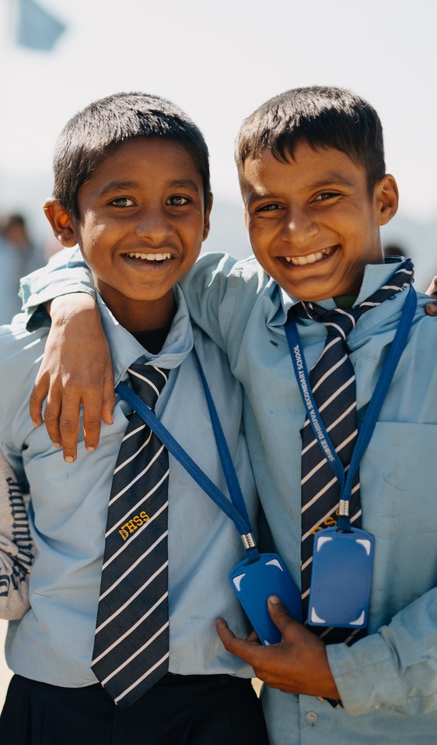
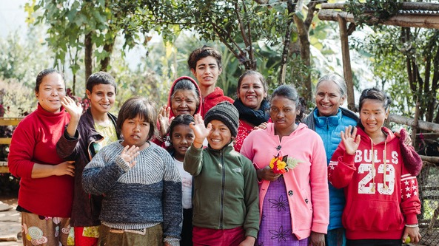
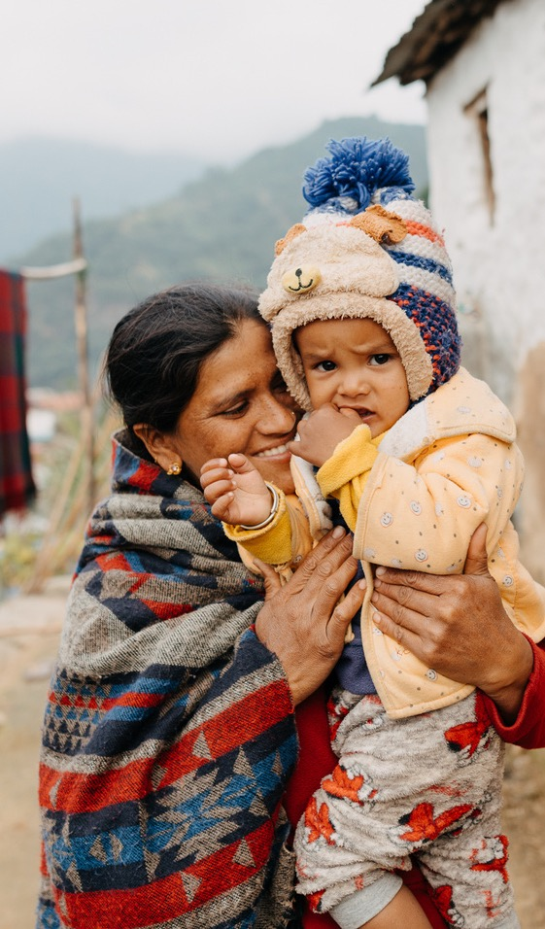
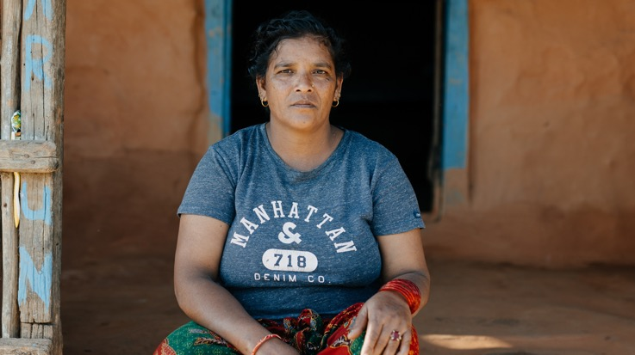
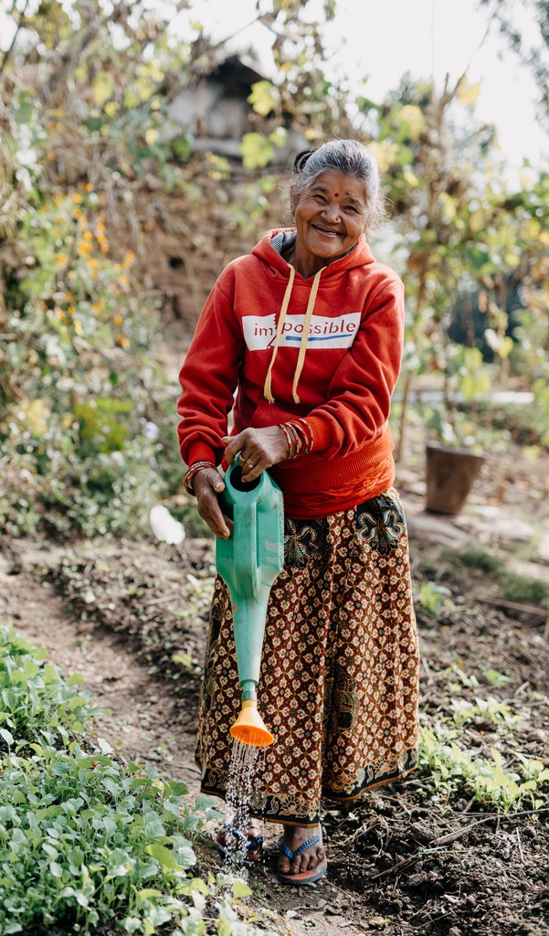
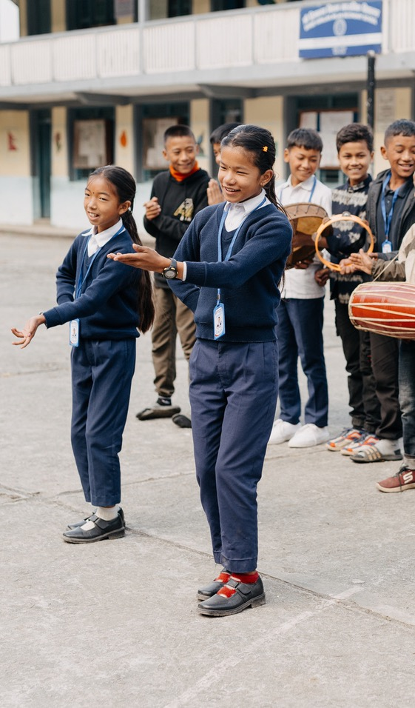
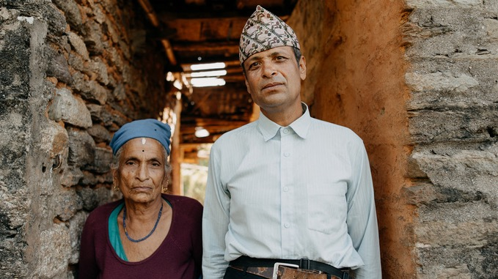

Slide 10
BINA

Slide 13
ANJILA, UJAN & CHABLI

Slide 15
DUJA

Slide 18
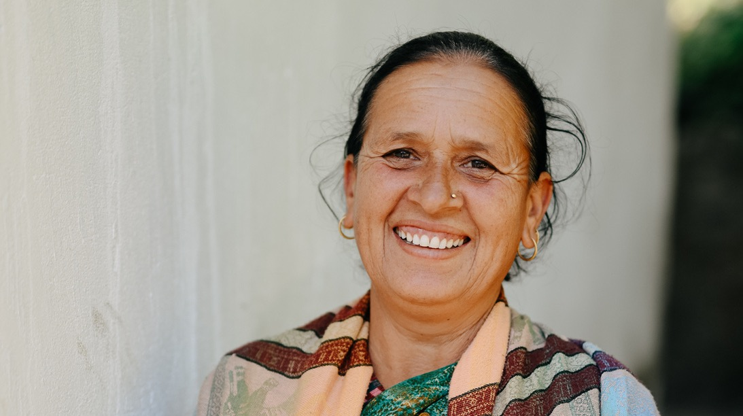
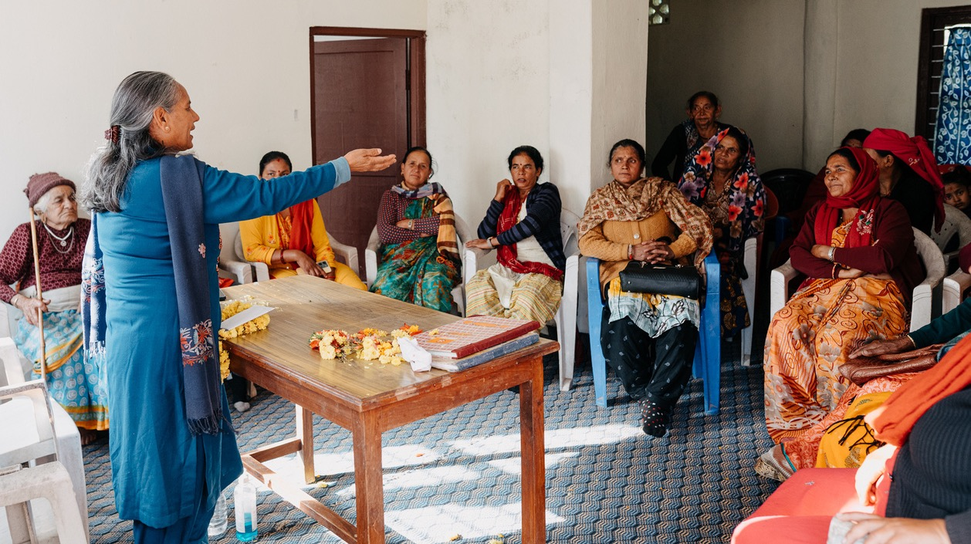

Slide 20
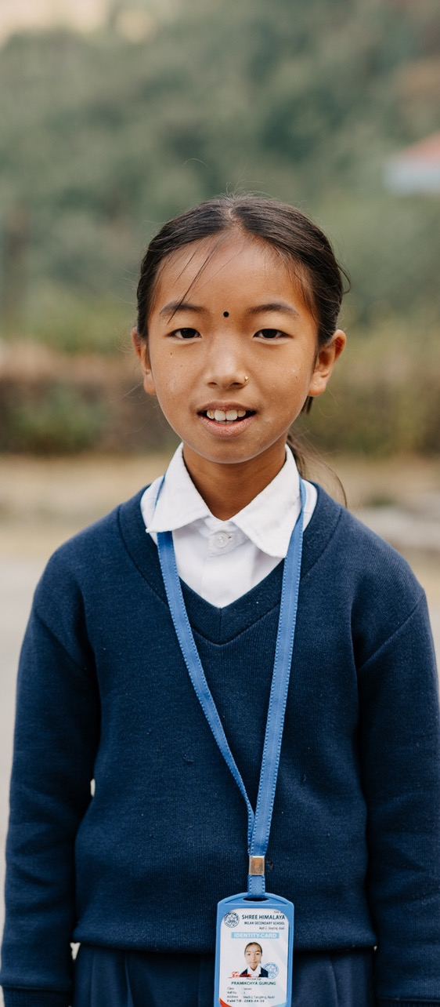
NABINA
ANITA
PRAMICKCHYNA
PRINCIPAL GURUNG

Slide 21
WHY
WORLD DEVELOPMENT
& RELIEF

Slide 22
TEN
TIMES MORE

Slide 23
"It is a great pleasure for me, on behalf of all the women and girls, and everyone at Kopila-Nepal, to give a sincere thanks for your support and we hope it will be a long partnership.
Thank you for your kind heart."
-Bina
WDR 2023/24

Slide 24
WHY
WORLD DEVELOPMENT
& RELIEF

Slide 25
irishmethodist.org/world-development

