Slide 1
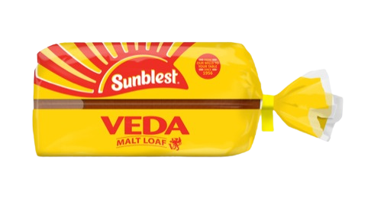
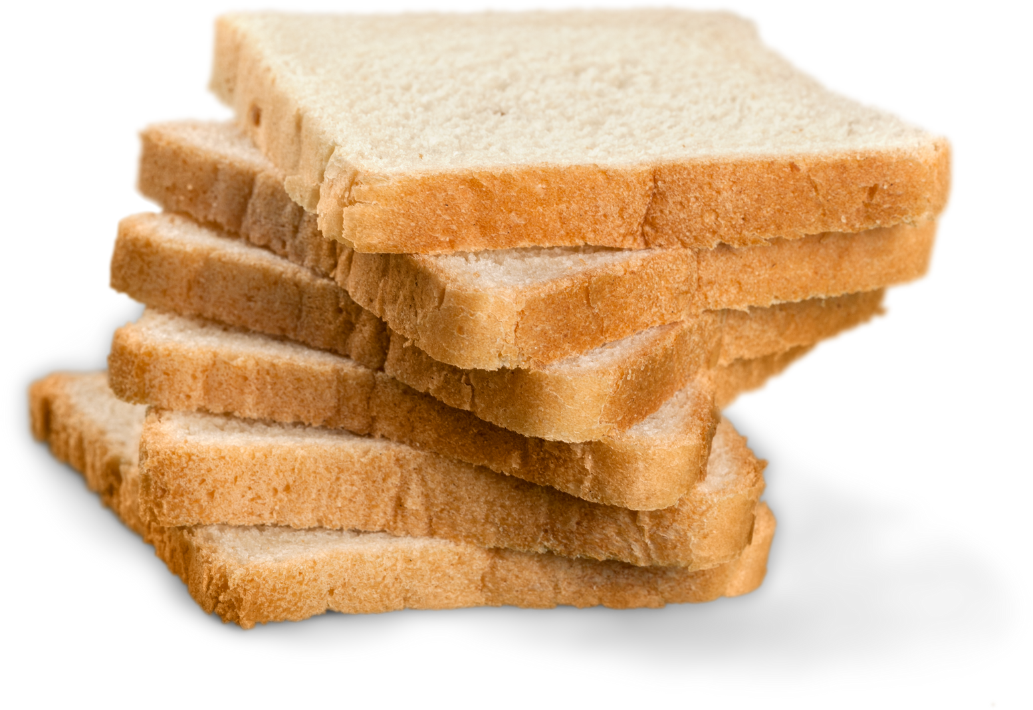
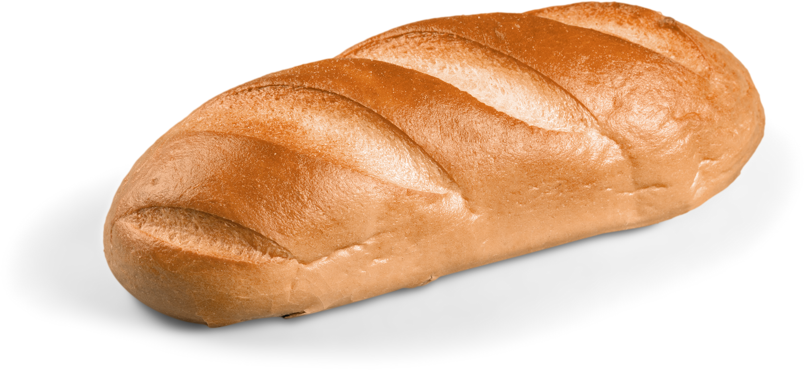
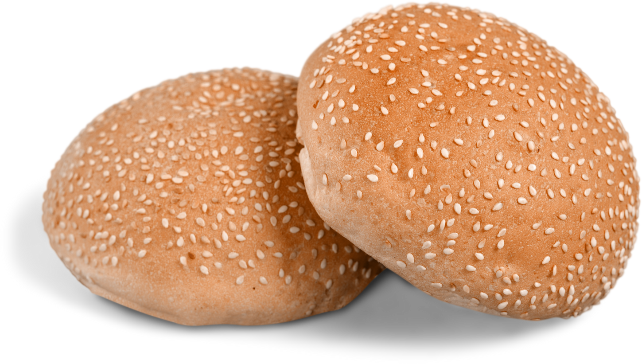

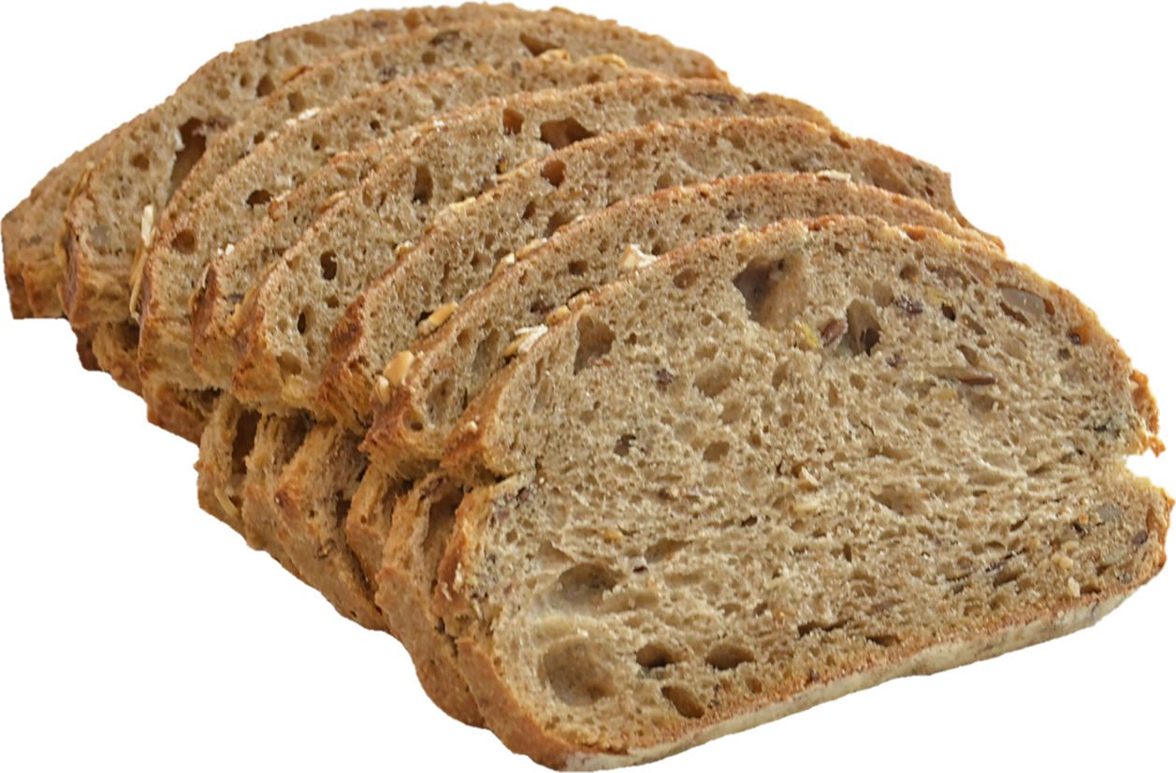
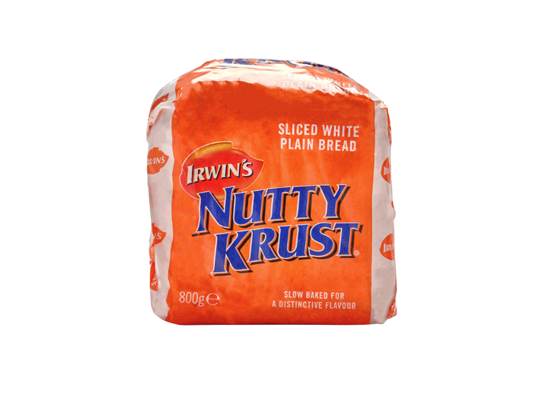
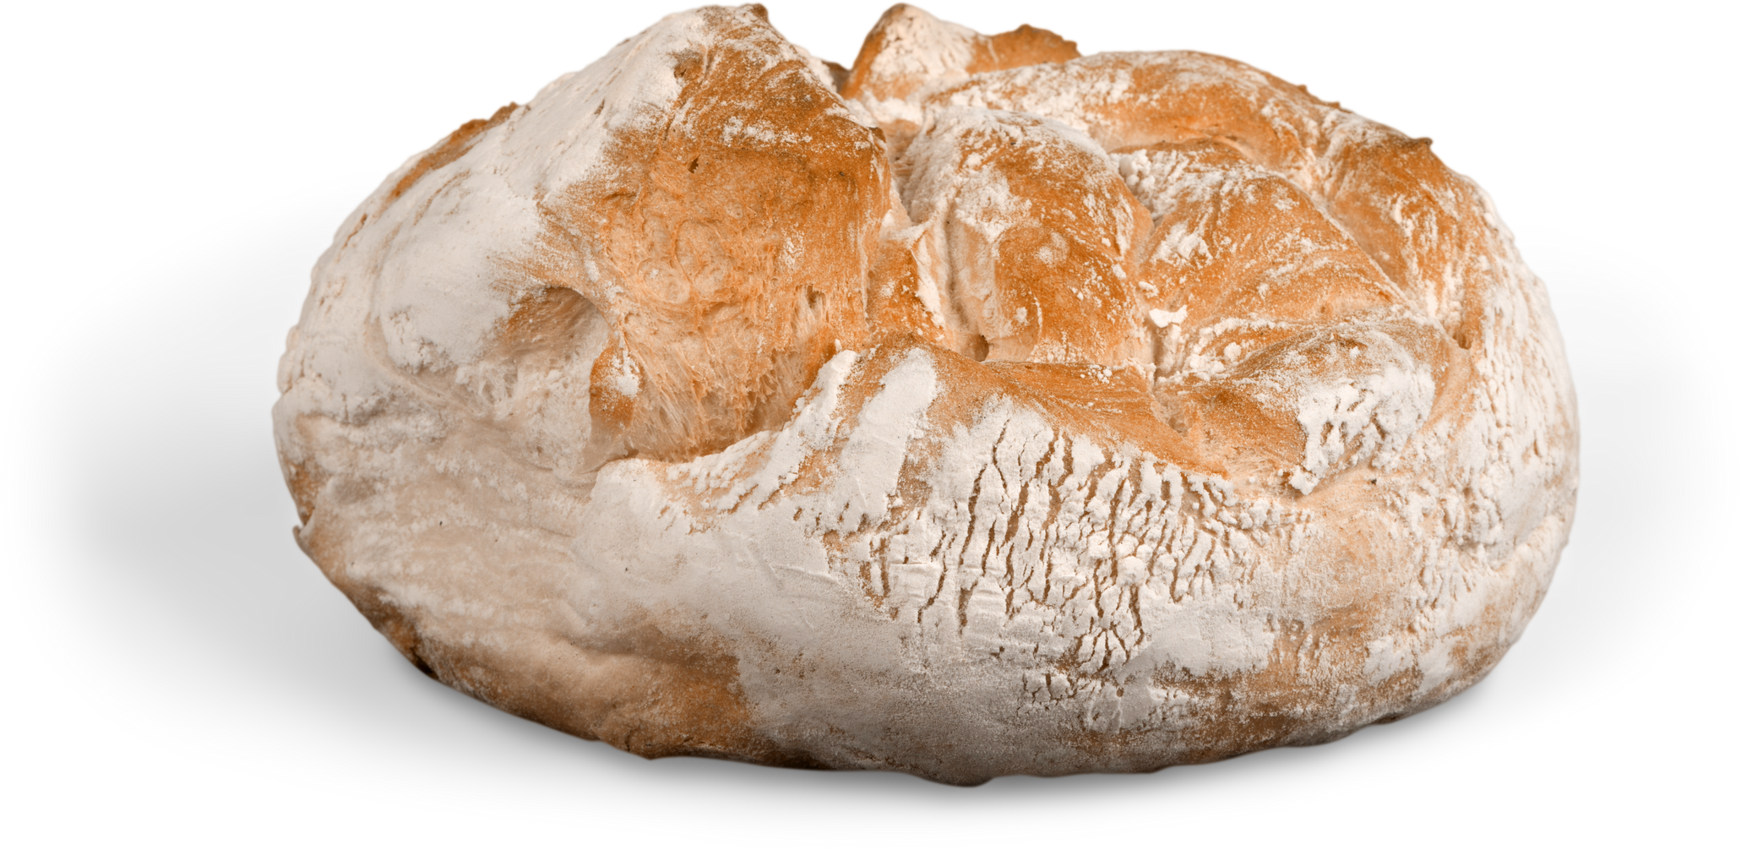

Slide 2

BY BREAD ALONE?

Slide 3


Slide 4

PRACTICAL
NEEDS
SPIRITUAL
NEEDS

Slide 5

PRAYER
God,
Thank you for giving us the things that we need,
And help us to care for those who don’t have as much as we do.
Help us to share our food, and the Good News about you,
So that everyone has enough to eat, and the promise of eternal life together.
Amen.

